Slide 1

MC Frontalot - It Is Pitch Dark
Notes:
MC Frontalot - It Is Pitch Dark
https://www.youtube.com/watch?v=4nigRT2KmCE

Slide 2
Text Adventure Games
Daphne Ippolito
Chris Callison-Burch
http://interactive-fiction-class.org

Slide 3
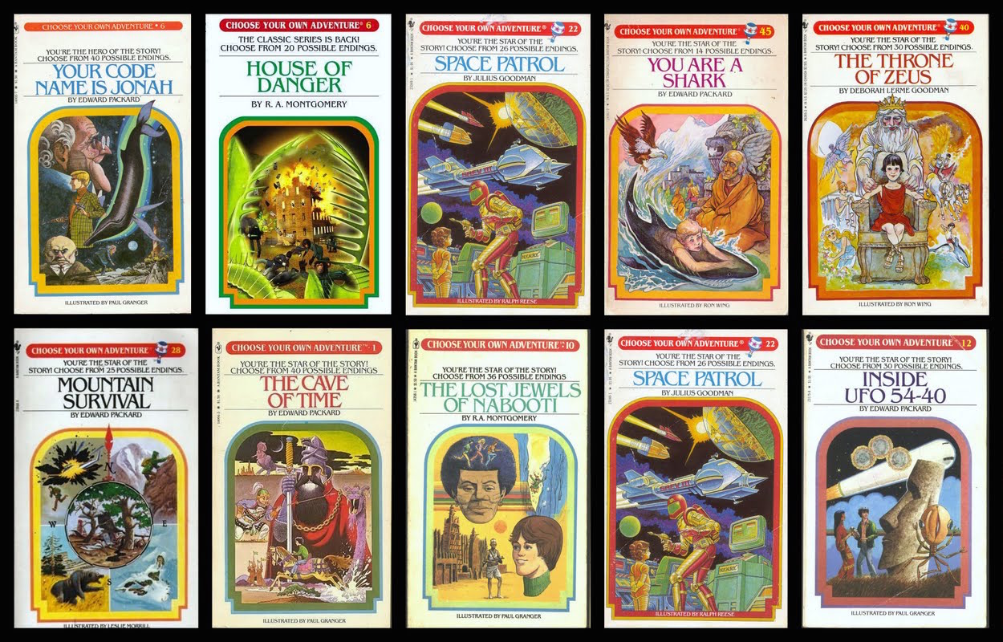
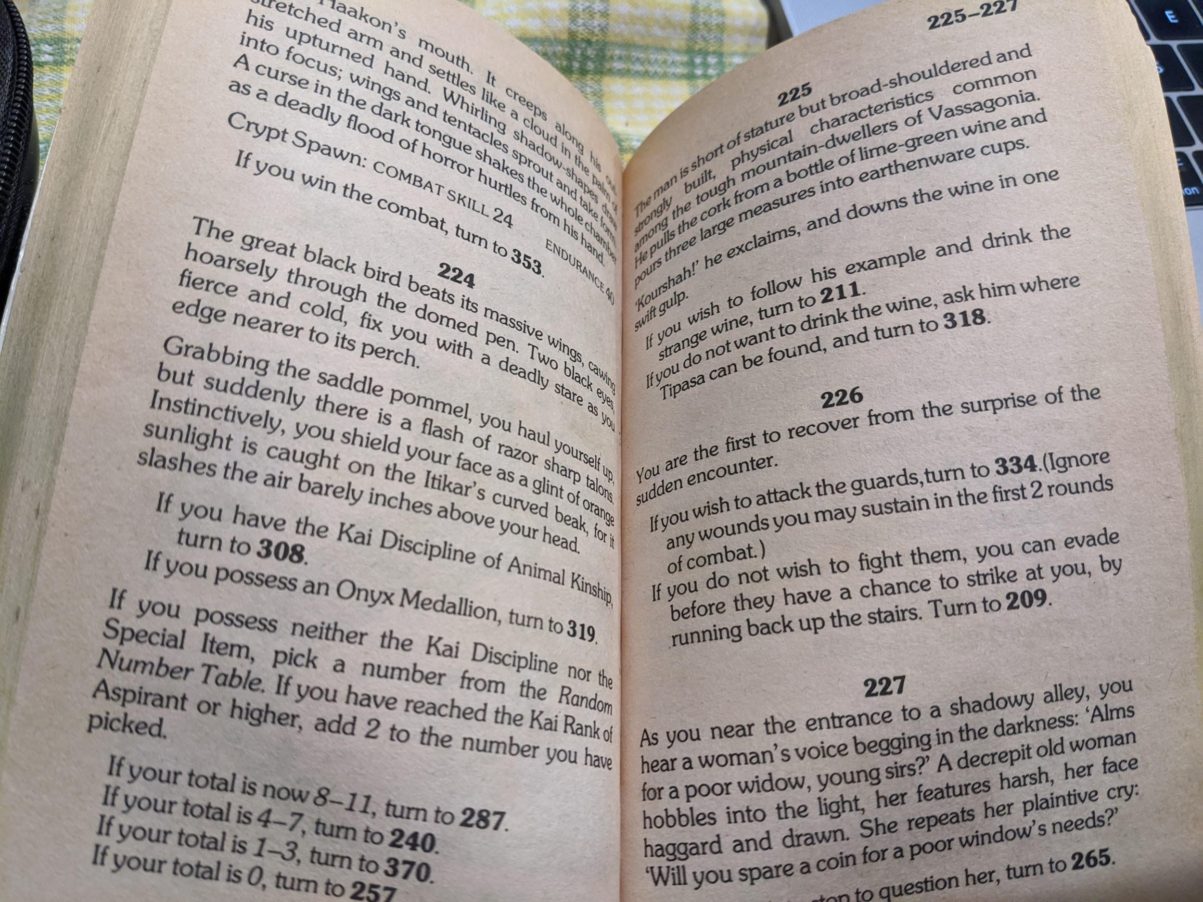
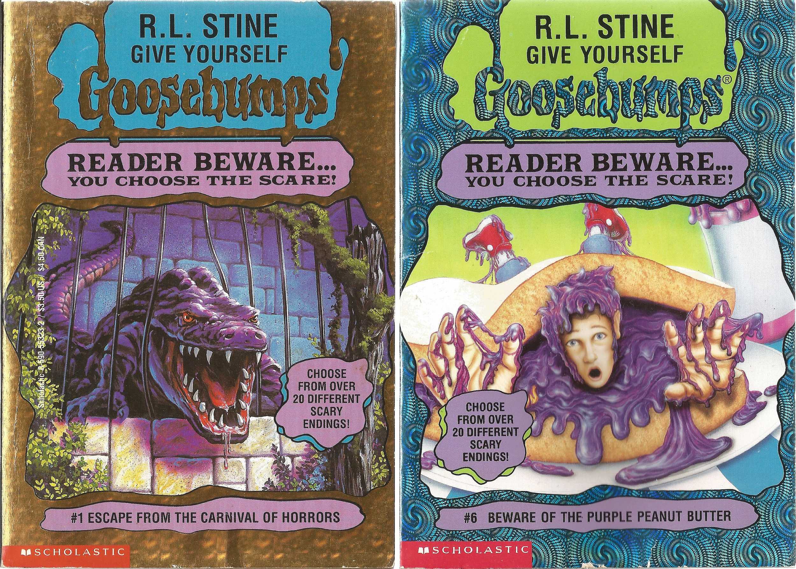
Paper Interactive Fiction
In the 1970s, “Choose your own adventure” books grew in popularity.
Notes:
If you possess the Onyx Medallion, turn to 319.

Slide 4
Notes:
From https://www.seanmichaelragan.com/html/[2008-03-07]_Choose_Your_Own_Adventure_book_as_directed_graph.shtml

Slide 5
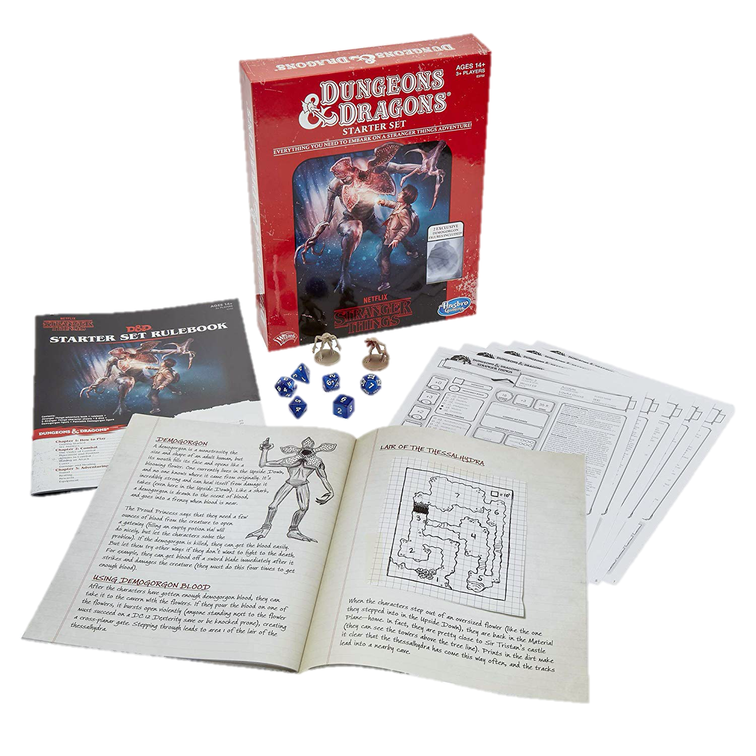
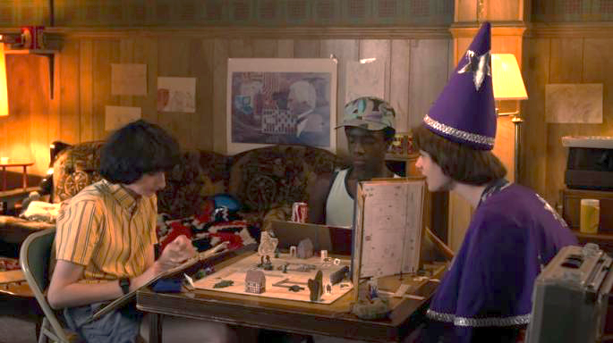
Paper & Pencil Interactive Fiction
Dungeons & Dragons is a fantasy tabletop role playing game first published in 1974.
Notes:
One forebearer of IF is the fantasy role-playing playing game Dungeons and Dragons, a framework for a theatrical interaction, for the exploration of simulated spaces, and for puzzle solving.

Slide 6
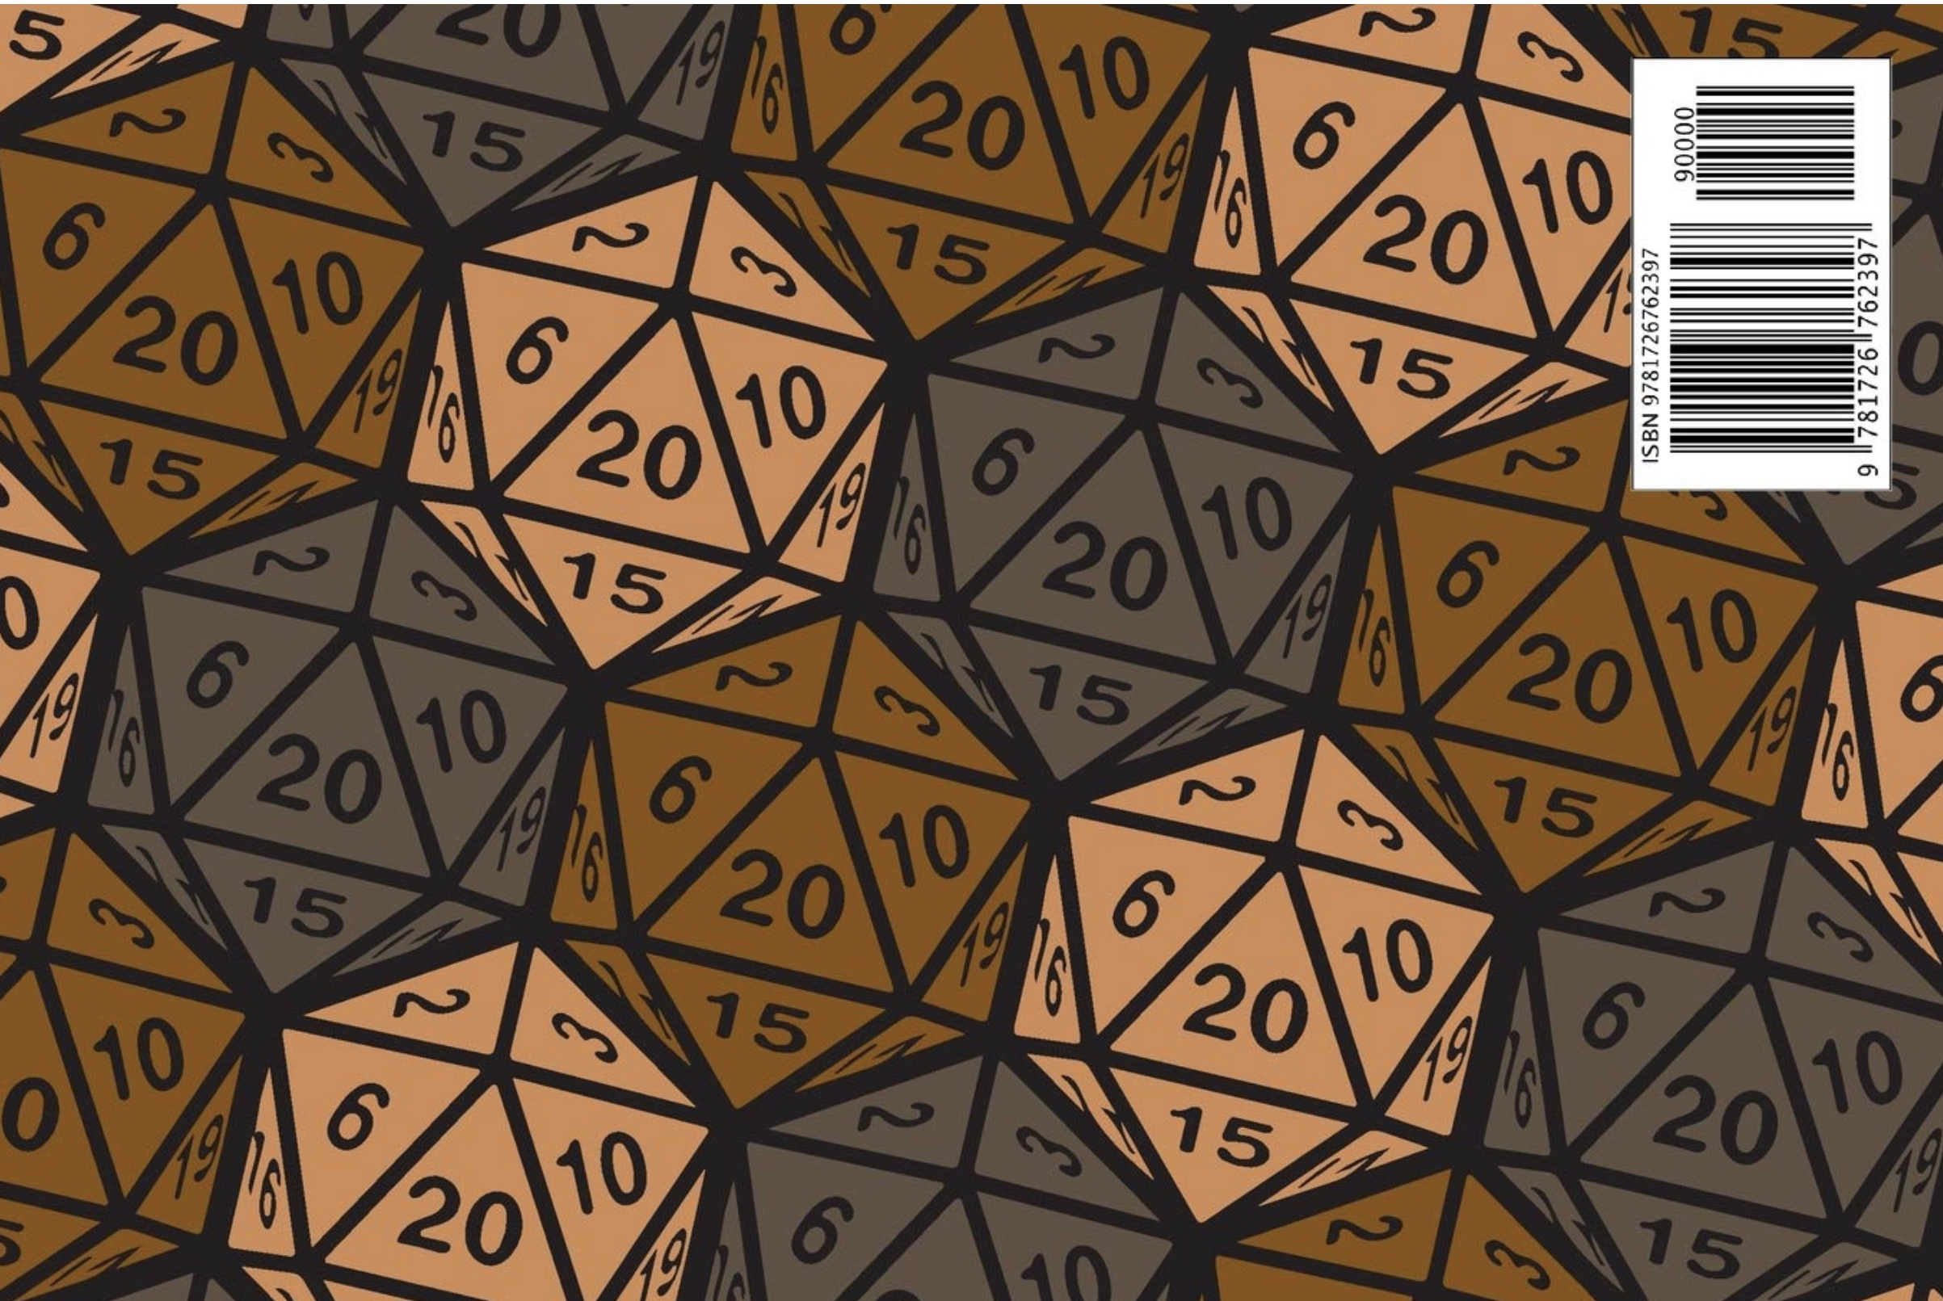
DUNGEONS AND DRAGON
D&D is an open-ended game in which the players assume the roles of characters in a story and can have them attempt any action they want. The game is controlled by a dungeon master, who uses tables, dice, and personal judgment to decide on the effect of a character’s efforts.
The players say what their characters do within the world of the campaign. Dice are rolled to help determine the outcome of combat and other encounters. Over the course of many adventures, the members of a party advance in level and become more powerful-and the dungeon master devises new challenges for them.
Notes:
Dice, are frequently used in a typical game. The twenty-sided die and other dice of unusual shape have become iconic. Dice are used to introduce unpredictability; based on the roll of a die, events may transpire that were not anticipated, foiling even the dungeon master’s plans.

Slide 7
Computer Games Before Graphics
Interactive Fiction/Text Adventure Games were the best-selling computer games of the 1980s. A company called Infocom created the most popular titles.

Slide 9
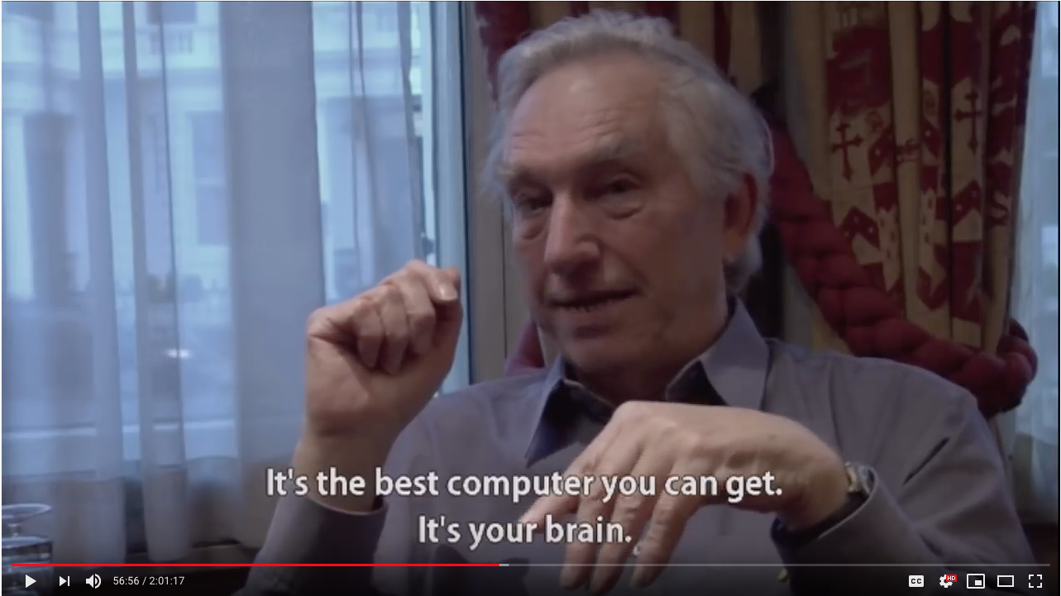
https://www.youtube.com/watch?v=LRhbcDzbGSU&t=3398
Notes:
https://www.youtube.com/watch?v=LRhbcDzbGSU&t=3398
Start at 56:38 - Best computer you can get is your brain / joy of reading + stori
End at 58:21 - Potential end point (“A story can have meaningful consequences … in a way that had never been seen before”)

Slide 10
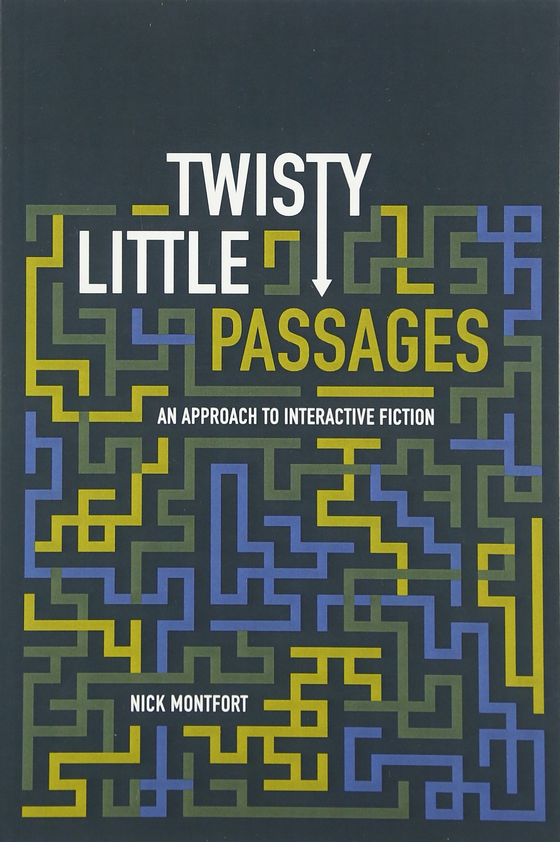
Interactive Fiction Games
The two essential components of interactive fiction are
The parser, which is the component that analyzes natural language input in an interactive fiction work.
The world model, which is setting of an interactive fiction work.
Notes:
The simulated world is represented computationally in some sort of data structure or collection of objects. It is this simulated world that distinguishes a work of interactive fiction from a conversational character or from an expert system that employs natural language understanding.

Slide 11
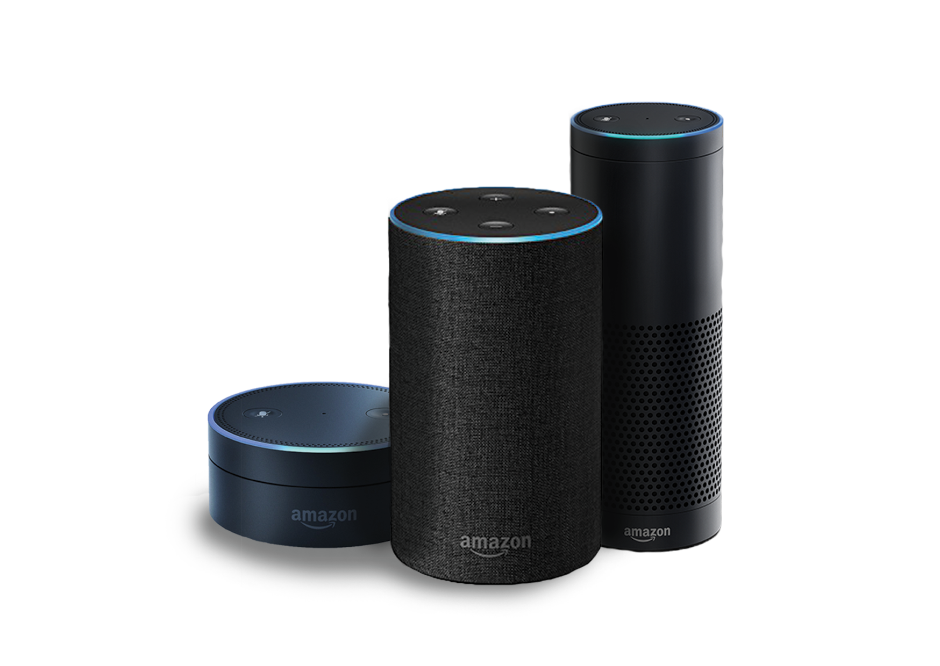

Natural Language Understanding
Will it rain tomorrow? Set an alarm for 6:30a.m. Play music from They Might Be Giants. How many pints are in a gallon? Add blueberries to my shopping list. When did California become a state? When is the Winter solstace? What is the weather like in Hawaii this weekend? Turn off the lights. Open the pod bay doors.

Slide 12
Turing Test
The idea of computer conversation was developed along with the general-purpose purpose digital compute. Turing presented it in his 1950 paper “Computing Machinery and Intelligence”. Which introduced the Turing Test. The question “Can machines think?” could then be replaced by one that was easier to answer: “Are there imaginable digital computers which would do well in the imitation game?”
Turing highlighted lighted the importance of conversational ability to our perception of intelligence, at a time when computers almost exclusively processed numbers rather than language.
Notes:
The idea of computer conversation was developed along with the general-purpose purpose digital computer; Turing (1950) presented it quite clearly in his influential paper “Computing Machinery and Intelligence,” in which he established the Turing Test. He gave the example of a parlor game in which a person of one gender tries to imitate a person of the other, and then suggested a similar game in which a computer would imitate a human in conversation. The question “Can machines think?” could then be replaced by one that was easier to answer: “Are there
imaginable digital computers which would do well in the imitation game?” (Turing 1950, 54-55). In formulating this test, Turing highlighted lighted the importance of conversational ability to our perception of intelligence, at a time when computers almost exclusively processed numbers rather than language.
The “imitation game” is a party game, where a man and a woman go into separate rooms and guests try to tell them apart by writing a series of questions and reading the typewritten answers sent back. In this game both the man and the woman aim to convince the guests that they are the other.
"Computing Machinery and Intelligence" (Mind, October 1950), Turing addressed the problem of artificial intelligence, and proposed an experiment that became known as the Turing test, an attempt to define a standard for a machine to be called "intelligent". The idea was that a computer could be said to "think" if a human interrogator could not tell it apart, through conversation, from a human being.

Slide 13
Turing Test
A human evaluator would judge text-based conversations between a human and a machine designed to generate human-like responses. If the evaluator cannot reliably tell the machine from the human, the machine is said to have passed the test. The test results do not depend on the ability to give correct answers to questions, only how closely one's answers resemble those a human would give.
Notes:
The idea of computer conversation was developed along with the general-purpose purpose digital computer; Turing (1950) presented it quite clearly in his influential paper “Computing Machinery and Intelligence,” in which he established the Turing Test. He gave the example of a parlor game in which a person of one gender tries to imitate a person of the other, and then suggested a similar game in which a computer would imitate a human in conversation. The question “Can machines think?” could then be replaced by one that was easier to answer: “Are there
imaginable digital computers which would do well in the imitation game?” (Turing 1950, 54-55). In formulating this test, Turing highlighted lighted the importance of conversational ability to our perception of intelligence, at a time when computers almost exclusively processed numbers rather than language.
The “imitation game” is a party game, where a man and a woman go into separate rooms and guests try to tell them apart by writing a series of questions and reading the typewritten answers sent back. In this game both the man and the woman aim to convince the guests that they are the other.
"Computing Machinery and Intelligence" (Mind, October 1950), Turing addressed the problem of artificial intelligence, and proposed an experiment that became known as the Turing test, an attempt to define a standard for a machine to be called "intelligent". The idea was that a computer could be said to "think" if a human interrogator could not tell it apart, through conversation, from a human being.

Slide 14
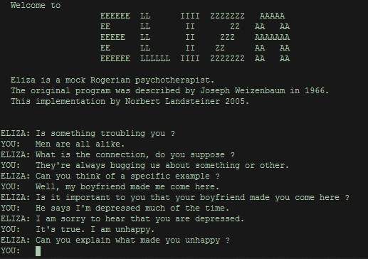
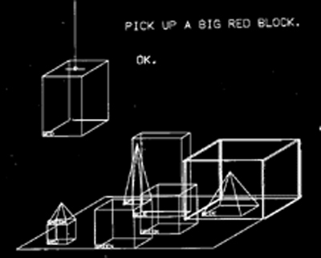
Early Natural Language Understanding
Notes:
The software programs ELIZA (1964–1966) and SHRDLU (1968–1970) were examples of early interactive natural language understanding. Both programs used natural language processing (NLP) to take input from their user and respond in a virtual and conversational manner. ELIZA simulated a psychotherapist that appeared to provide human-like responses to the user’s input, while SHRDLU employed an artificial intelligence that could move virtual objects around an environment and respond to questions asked about the environment’s shape. The development of effective natural language processing is an important part of interactive fiction development.

Slide 15
ELIZA
ELIZA is a language analysis program that can run scripts to have different sorts of conversations; the most famous script was DOCTOR, which was “designed to permit it to play (or parody) the role of a Rogerian psychotherapist engaged in an interview with a patient”.
ELIZA was the first computer conversationalist, the first chatbot. ELIZA searched for keywords in input. If some were found, the program would transform the input according to a rule and print out the transformed sentence. If none were found, it would provide a default (usually noncommittal) output like “What makes you say that?”
Notes:
ELIZA is a language analysis program that can run many different ferent scripts and have different sorts of conversations; the most famous script by far was called DOCTOR, which Weizenbaum (1976) explained was “designed to permit it to play (I should really say parody) the role of a Rogerian psychotherapist engaged in an initial interview with a patient”.
Although ELIZA was later used to do more sophisticated types of natural language understanding (Weizenbaum 1967; Winograd 1972, 38), Weizenbaum (1976) made it clear that it in no way offered a general solution tion to the problem of natural language understanding.
Nevertheless, users were quite affected by it. Weizenbaum wrote that he “was startled to see how quickly and how very deeply people conversing with DOCTOR became emotionally involved with the computer” (6). Janet Murray (1997) described him as being “so disconcerted by his achievement that he wrote a book warning of the dangers of attributing human thought to machines” (71).
Some psychiatrists thought ELIZA/DOCTOR should be used in therapy; apy; people took contradictory positions on big questions in artificial intelligence gence based on ELIZA/DOCTOR; and the program inspired its own branch of computer literature based on conversation with fictional characters ters

Slide 16
SHRDLU
Terry Winograd’s SHRDLU had a dialog with the user via teletype and displayed an image of a tabletop with blocks on it. It could respond to natural language commands in real time. It would move the simulated blocks around if asked to; it could also answer questions about them.
SHRDLU used its knowledge of the simulated world to help it parse input. It represented its knowledge as procedures. SHRDLU had several different components. There was a module for generating replies to the user,, and one for simulating the blocks world.
Notes:
Terry Winograd’s SHRDLU, which he programmed in LISP at the MIT Artificial Intelligence Laboratory during ing 1968-1970
This program (named after the second row of keys on a Linotype machine; see Winograd 1999)) carried on a dialog with the user via teletype, also displaying an image of a tabletop with blocks on it. It could respond to natural language commands in real time,
It would move the simulated blocks around if asked to; it could also answer questions about them.
SHRDLU used its knowledge of the simulated world to help it parse input. It represented its knowledge as procedures.
SHRDLU had eleven different components. There was a module for generating replies to the user, for instance, and one for simulating the blocks world (Winograd 1972). Here is a short excerpt from a much longer SHRDLU sample transcript:
SHRDLU was able to understand almost any input just about anything that a human could understand-as long as it pertained to the blocks world.

Slide 17
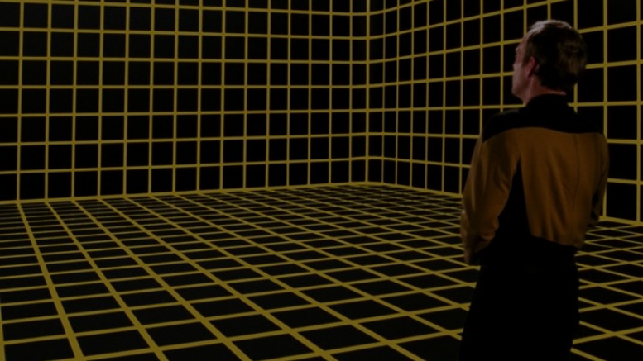
Simulated World
What’s the difference between a conversational agent and a work of interactive fiction? The simulated world.
It represents the physical environment, and things like • Settings or locations • Physical objects in each setting • The player’s character • Non-player characters It also represents and simulates the physical laws of the environment.
Notes:
The world model is typically implemented in the interactive fiction program as some type of graph or tree with associated procedures.

Slide 18
Locations
YOU ARE AT A COMPLEX JUNCTION. A LOW HANDS AND KNEES PASSAGE FROM THE NORTH JOINS A HIGHER CRAWL FROM THE EAST TO MAKE A WALKING PASSAGE GOING WEST. THERE IS ALSO A LARGE ROOM ABOVE. THE AIR IS DAMP HERE.
A location in Adventure

Slide 19
Maps and Mazes
There was a maze Adventure that was essentially impossible to get through without making a map.
The pirate’s maze offers rooms that are all uniformly described as “a maze of twisty little passages, all alike.”
To figure out which room is which, the player character must drop objects to mark the different rooms. The rooms, once all alike, can then be differentiated based on their contents and mapping ping of the usual sort is possible.

Slide 20
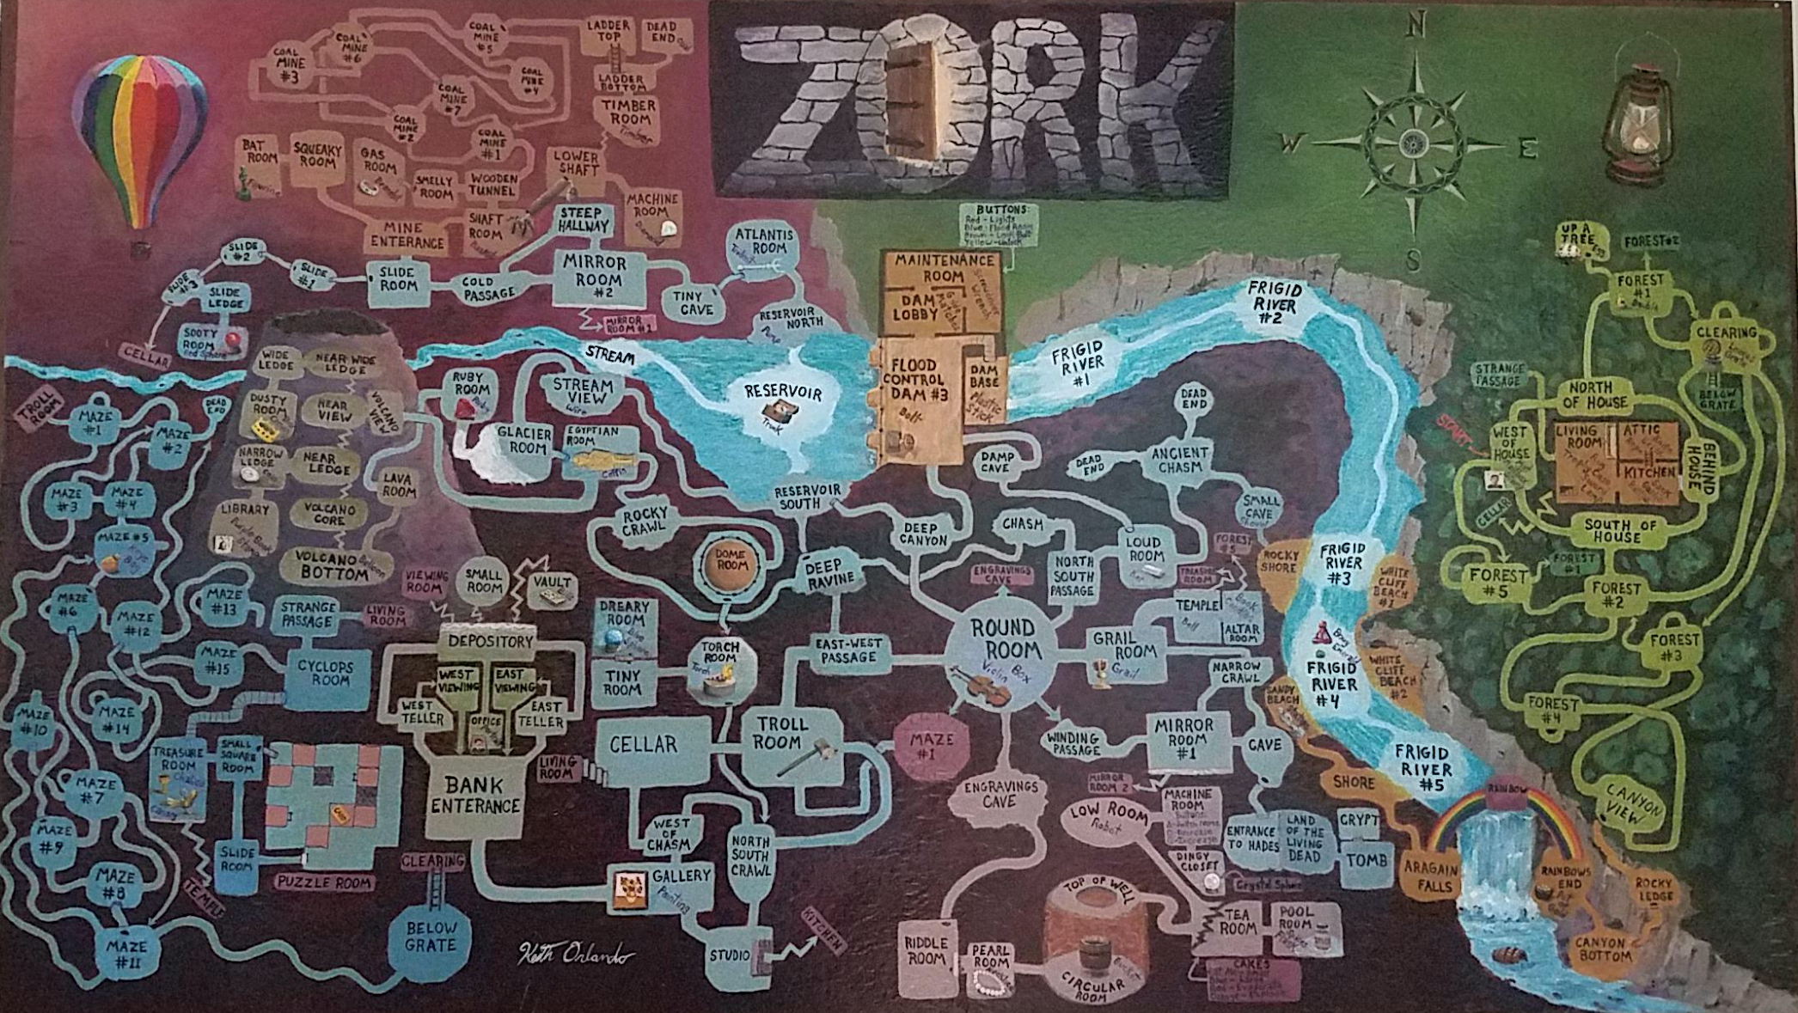
Notes:
Credit: Reddit user ion_bond Source URL: https://www.reddit.com/r/zork/comments/5ximil/zork_map_mit_version_fantastic_game_i_spent_some/

Slide 21
Objects
In Adventure, instead of a realistic simulation of caving, the author placed five treasures within as an incentive to explore the cave. The player also has to figure out how to get past a snake to move deeper into the cave. The player is attacked dwarves and their treasure is stolen by a pirate.

Slide 23
Verbs
Players input simple sentences such as “get key” or “go east”, which are interpreted by a text parser. Parsers may vary in sophistication; the first text adventure parsers could only handle two-word sentences in the form of verb-noun pairs.
Notes:
In the case of Adventure’s “two-word” parser, which only accepts input of the form “verb” or “verb noun,” determining the grammatical structure of the input is trivial.

Slide 24
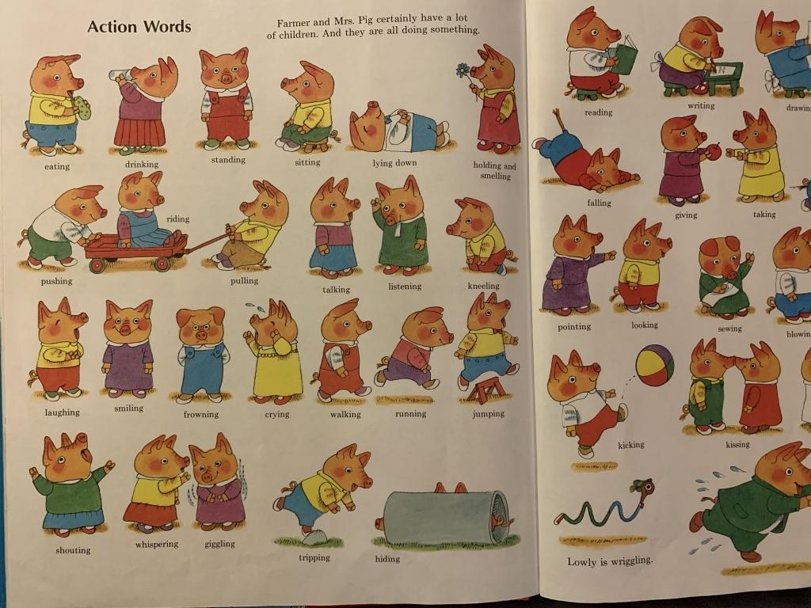
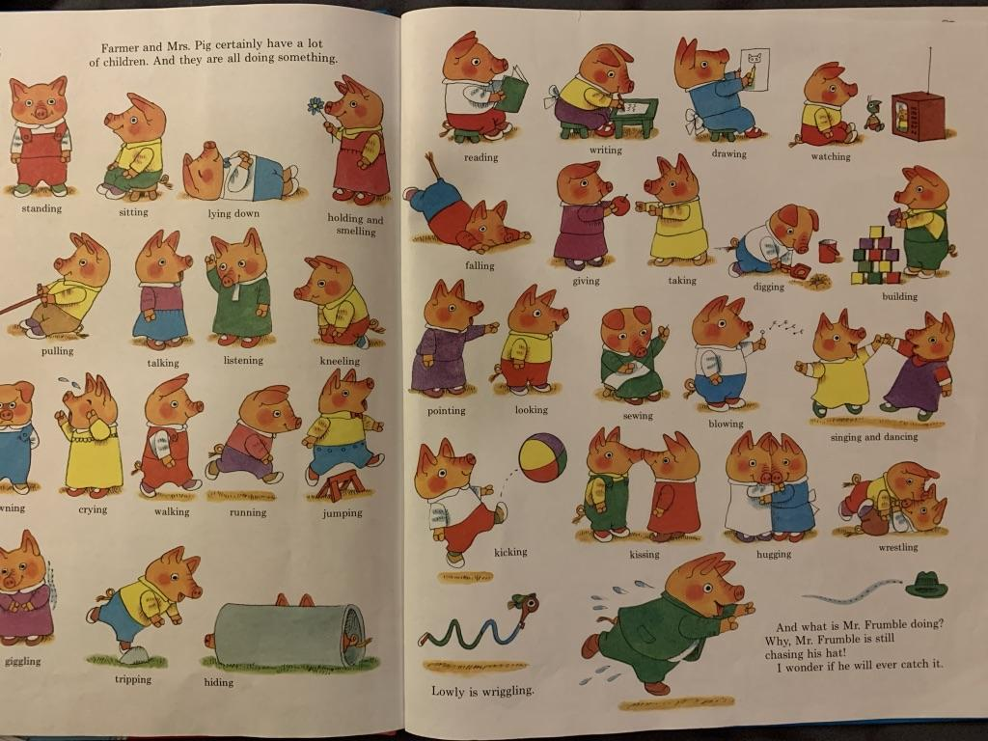
Notes:
Verbs

Slide 25
“open the red box with the green key then go north”.
Later parsers, such as those built on ZIL (Zork Implementation Language), could understand complete sentences. They could handle more complex inputs.

Slide 26
Early Parsers
Adventure’s language parser was extremely primitive but removed ambiguity.
Adventure, with its primitive but effective way of understanding language, that endures and that became widespread. It also became the archetype of the text adventure and of interactive active fiction.

Slide 27
Z-machine
Infocom developed a virtual machine to deploy standardized “story files” on many platforms. The Infocom parser was the best of its era. It accepted complex, complete sentence commands when its competitors’ parsers were restricted to simple two-word verb-noun combinations. Its parser was actively upgraded, and later games would ‘understand’ multiple sentence input: ‘pick up the gem and put it in my bag. take the newspaper clipping out of my bag then burn it with the book of matches’.
Notes:
Infocom developed a custom virtual machine that could be implemented on a large number of platforms, and took standardized “story files” as input. Infocom was responsible for developing the interactive style that would be emulated by many later interpreters. The Infocom parser was widely regarded as the best of its era. It accepted complex, complete sentence commands like “put the blue book on the writing desk” at a time when most of its competitors parsers were restricted to simple two-word verb-noun combinations such as “put book”. The parser was actively upgraded with new features like undo and error correction, and later games would ‘understand’ multiple sentence input: ‘pick up the gem and put it in my bag. take the newspaper clipping out of my bag then burn it with the book of matches’.

Slide 28
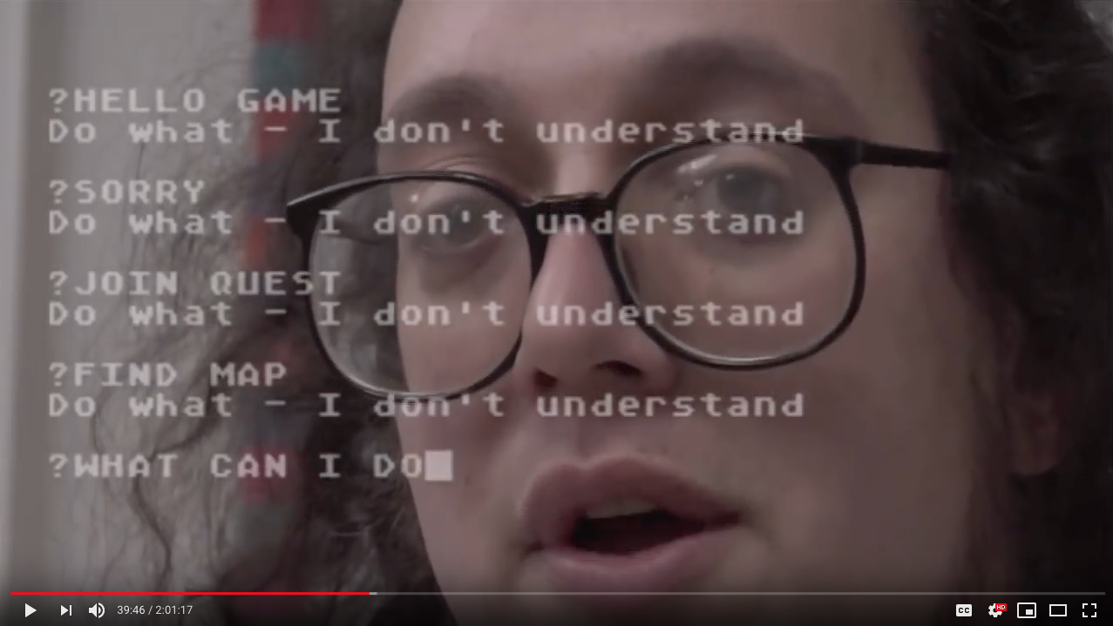
https://www.youtube.com/watch?v=LRhbcDzbGSU&t=2361
Notes:
https://www.youtube.com/watch?v=LRhbcDzbGSU&t=2361
4 minute clip – end at 43:25 (kill the player)
39:20 - Language understanding difficulty
41:30 - ELIZA
43:10 - potential end point (after you’ve implemented it yourself, your perspective changes)
43:25 - potential end point (we just killed the player)

Slide 29
Why were parsers so bad?

Slide 30
Puzzles
In most interactive fiction, puzzles (sorts of challenges or obstacles) are part of the world the player character moves through. In order to complete the IF work, the interactor must figure out how to meet these challenges.

Slide 31
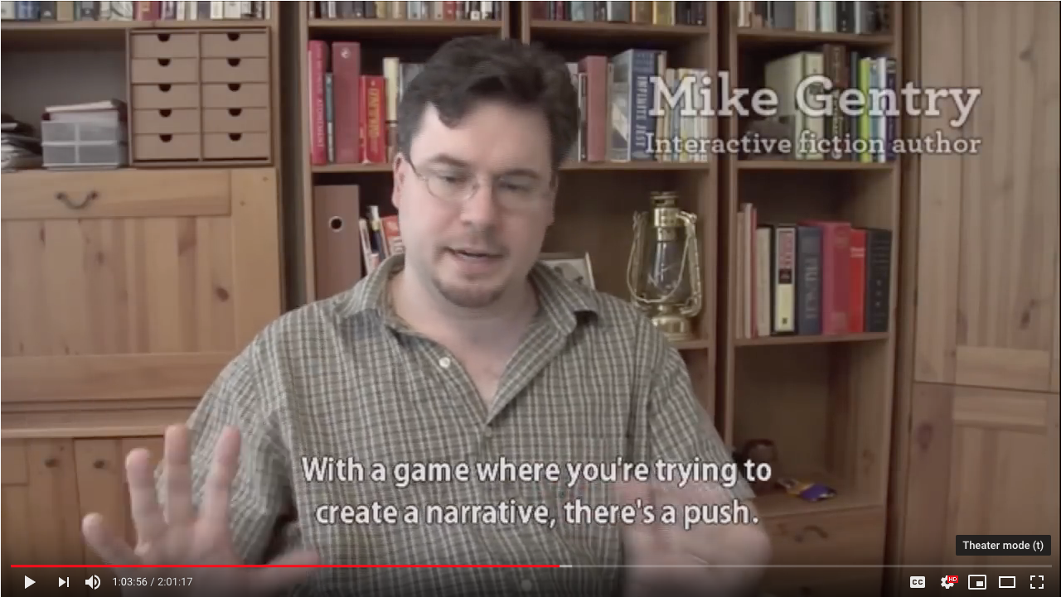
https://www.youtube.com/watch?v=LRhbcDzbGSU&t=3819
Notes:
Puzzles – 2 minutes. https://www.youtube.com/watch?v=LRhbcDzbGSU&t=3819
103:50 - narrative+puzzles
End. 105:56 The actual act of winning is trivial

Slide 32
Puzzle Solutions
The solutions may be arrived at through the player character’s senses or by having the player character manipulate things in the surroundings and then observe the results to determine the workings of the world.
Most interactive fiction does not have great replay value. You cannot simply “replay” a riddle if you know its answer.
However, once you learn to play a board game, the knowledge gained from playing it once game doesn’t ruin the experience of playing it again.

Slide 33
Writing Style
Interactive fiction features two distinct modes of writing: the player input and the game output. Player input is expected to be in simple command form (in linguistics sentences in command form are called imperative sentences).
> look in tea chest

Slide 34
“That was the first place you tried, hours and hours ago now, and there’s nothing there but that boring old book. You pick it up anyway, bored as you are”. –Graham Nelson Curses (1993)
The responses from the game are usually written from a second-person point of view, in present tense.
Notes:
This is because, unlike in most works of fiction, the main character is closely associated with the player, and the events are seen to be happening as the player plays.
Some IF works dispense with second-person narrative entirely, opting for a first-person perspective (‘I’) or even placing the player in the position of an observer, rather than a direct participant.

Slide 35
"I could not unlove him now, merely because I found that he had ceased to notice me". – Charlotte Brontë's Jane Eyre (1847)
First-person – A first-person narrative is a mode of storytelling in which a narrator relays events from their own point of view using the first-person pronouns "I" or "we”. The narrator is the protagonist, or retelling events that they witnessed.
Notes:
In Jane Eyre the title character is telling her own story.
Other examples of first person narration: fictional autobiographies, detective fiction, internal monologues,
https://en.wikipedia.org/wiki/First-person_narrative This device allows the audience to see the narrator's mind's eye view of the fictional universe, but it is limited to the narrator's experiences and awareness of the true state of affairs,
With a first person narrative it is important to consider how the story is being told, i.e., is the character writing it down, telling it out loud, thinking it to themselves? And if they are writing it down, is it something meant to be read by the public, a private diary, or a story meant for one other person? The way the first person narrator is relating the story will affect the language used, the length of sentences, the tone of voice and many other things. A story presented as a secret diary could be interpreted much differently than a public statement.^{[2]}
https://en.wikipedia.org/wiki/Narration A first-person point of view reveals the story through a participant narrator. First person creates a close relationship between the narrator and reader, by referring to the viewpoint character with first person pronouns like I (or we, if the narrator is part of a larger group).^{[12]} That is, the narrator openly acknowledges their own existence. Frequently, the first-person narrator is the protagonist, whose inner thoughts are expressed to the audience, even if not to any of the other characters. A first person narrator with limited omniscience is not able to witness or understand all facets of any situation. Thus, a narrator with this perspective will not be able to report the circumstances fully and will leave the reader with a subjective record of the plot details. Additionally, this narrator's character could be pursuing a hidden agenda or may be struggling with mental or physical challenges that further hamper their ability to tell the reader the whole, accurate truth of events. This form includes temporary first-person narration as a story within a story, wherein a narrator or character observing the telling of a story by another is reproduced in full, temporarily and without interruption shifting narration to the speaker. The first-person narrator can also be the focal character.

Slide 36
First-person – A first-person narrative is a mode of storytelling in which a narrator relays events from their own point of view using the first-person pronouns "I" or "we”. The narrator is the protagonist, or retelling events that they witnessed.

Slide 37
"You are not the kind of guy who would be at a place like this at this time of the morning. But here you are, and you cannot say that the terrain is entirely unfamiliar, although the details are fuzzy.” Jay McInerney's Bright Lights, Big City (1984)
Second-Person – The reader is character within the story. This is done with the use of second-person pronouns like you. Stories and novels in second person are comparatively uncommon.
Notes:
In Jane Eyre the title character is telling her own story.
https://en.wikipedia.org/wiki/First-person_narrative This device allows the audience to see the narrator's mind's eye view of the fictional universe, but it is limited to the narrator's experiences and awareness of the true state of affairs
https://en.wikipedia.org/wiki/Narration A first-person point of view reveals the story through a participant narrator. First person creates a close relationship between the narrator and reader, by referring to the viewpoint character with first person pronouns like I (or we, if the narrator is part of a larger group).^{[12]} That is, the narrator openly acknowledges their own existence. Frequently, the first-person narrator is the protagonist, whose inner thoughts are expressed to the audience, even if not to any of the other characters. A first person narrator with limited omniscience is not able to witness or understand all facets of any situation. Thus, a narrator with this perspective will not be able to report the circumstances fully and will leave the reader with a subjective record of the plot details. Additionally, this narrator's character could be pursuing a hidden agenda or may be struggling with mental or physical challenges that further hamper their ability to tell the reader the whole, accurate truth of events. This form includes temporary first-person narration as a story within a story, wherein a narrator or character observing the telling of a story by another is reproduced in full, temporarily and without interruption shifting narration to the speaker. The first-person narrator can also be the focal character.

Slide 38
Second-Peron – The reader is character within the story. This is done with the use of second-person pronouns like you. Stories and novels in second person are comparatively uncommon.

Slide 39
Third-Person – The narrator refers to all characters with third person pronouns like he, she, or they, and never first- or second-person pronouns. This makes it clear that the narrator is an unspecified entity or uninvolved person who conveys the story and is not a character of any kind within the story.
Notes:
Traditionally, third-person narration is the most commonly used narrative mode in literature. It does not require that the narrator's existence be explained or developed as a particular character, as would be the case with a first-person narrator. It thus allows a story to be told without detailing any information about the teller (narrator) of the story. Instead, a third-person narrator is often simply some disembodied commentary or voice, rather than a fully developed character.
https://en.wikipedia.org/wiki/Narration#Third-person

Slide 40
Stories

Slide 41

https://www.youtube.com/watch?v=LRhbcDzbGSU&t=3955
Notes:
https://www.youtube.com/watch?v=LRhbcDzbGSU&t=3955
Narratives (The quest – 1 minute)
105:55 - Robert Pinsky
107:06 - potential end - The imagery was very traditional

Slide 42
Artificial Intelligence

Slide 43
https://www.youtube.com/watch?v=WVIIigrPUJs&t=33
Notes:
3 minute clips
Text-based games are great tools for AI research because to succeed at a text-based game an AI needs to understand language, perform common-sense reasoning, deal with a combinatorial action space and overcome common reinforcement learning problems like partial observability and rewards sparsity. These skills are ultimately key skills needed for artificial general intelligence.

Slide 44
Text World
Text-based games are great tools for AI research because to succeed at a text-based game an AI needs to understand language, perform common-sense reasoning, deal with a combinatorial action space and overcome common reinforcement learning problems like partial observability and rewards sparsity. These skills are ultimately key skills needed for artificial general intelligence.
Notes:
3 minues at

